Slide 1
Unit 1: Language Preliminaries – .NET Framework
Comprehensive Coverage of .NET Fundamentals

Slide 2
What is .NET Framework?
Definition:
.NET is a virtual machine for compiling and executing programs written in multiple languages like C# and VB.NET.
Supports building form-based, web-based applications, and web services.
Key Features:
Portability,
memory management,
security, and
open-source contributions.

Slide 3
Advantages of .NET Framework
Memory Management (via Garbage Collection).
Common Type System (CTS): Enables language interoperability.
Extensive Class Library: Provides pre-built reusable components.
Version compatibility,
reliability, and
portability.

Slide 4
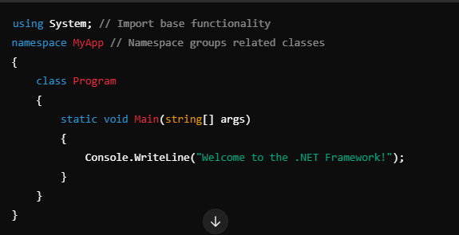
Main Components of .NET Framework
CLR (Common Language Runtime):
Manages memory, thread execution, and code execution.
Converts MSIL (Intermediate Language) to native machine code via JIT compilation.
FCL (Framework Class Library):
A rich library of reusable classes and methods.
Code Base/ Application:

Slide 5
Compilation and Execution Process
Stages of Code Execution
Compilation: Source code → MSIL.
Runtime Execution: MSIL → Native code via JIT.
Managed vs. Unmanaged Code
Managed Code: Controlled by CLR (e.g., C#, VB.NET).
Unmanaged Code: Outside CLR control (e.g., Win32 API).
(C# code →Language Compiler → IL → JIT → Native Code).

Slide 6
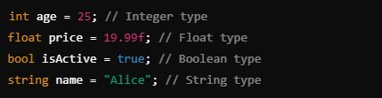
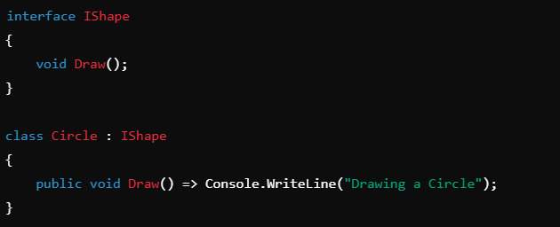
Language Constructs
Data Types
Definition:
Data types specify the type of data that variables can store.
Categories:
Value Types:
Store actual values.
Examples: int, float, bool.
Reference Types:
Store memory references.
Examples: string, object, arrays.

Slide 7


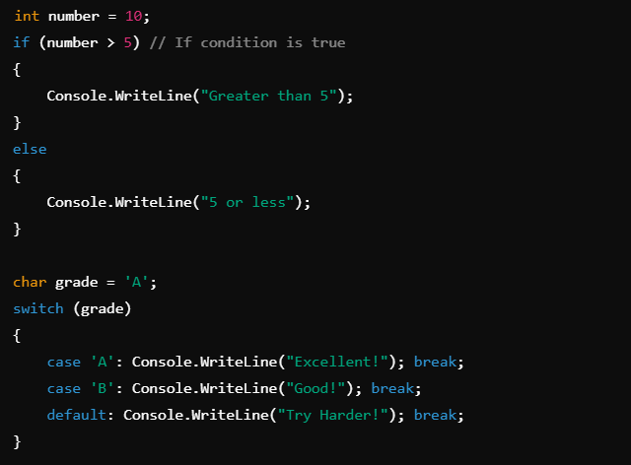
Variables & Conditional Statements
Variables: A variable is a named storage for data.
Rules:
Must begin with a letter or _.
Case-sensitive.
Cannot use keywords as names.
Conditional Statements:
Control the flow of execution based on conditions.
Types:
if-else: Executes code blocks based on conditions.
switch: Handles multiple conditions.

Slide 8
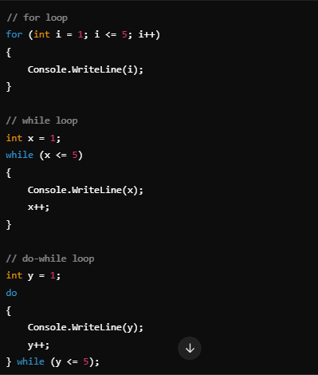
Looping Statements
Definition:
Execute code repeatedly based on a condition.
Types:
for loop: Iterates a fixed number of times.
while loop: Iterates while the condition is true.
do-while loop: Executes at least once, then checks the condition.

Slide 9
Arrays and Their Types
Definition:
Arrays are collections of elements of the same data type.
Types:
Single-Dimensional Array:
int[] numbers = { 1, 2, 3 };
Multi-Dimensional Array:
int[,] grid = { { 1, 2 }, { 3, 4 } };
int[,,] grid = { { 1, 2 }, { 3, 4}, {5, 6} };
Jagged Array: Array of arrays.
int[][] jagged = new int[2][];
jagged[0] = new int[] { 1, 2 };
jagged[1] = new int[] { 3, 4 };

Slide 10
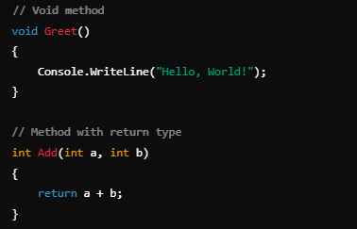
Functions and Methods
Definition:
Reusable blocks of code to perform tasks.
Types:
Void: No return value.
With Return Type: Returns a value.
Parameters: Pass data to methods.

Slide 11
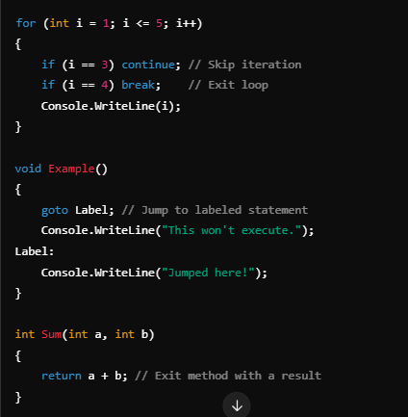
Jump Statements
Types:
break: Exits a loop or switch case.
continue: Skips the current iteration.
goto: Jumps to a labeled statement.
return: Exits a method and optionally returns a value.

Slide 12
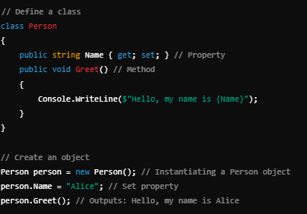
Object-Oriented Programming Features
Classes and Objects
What is a Class?
A class is a blueprint for creating objects.
It defines properties (attributes) and methods (behavior).
What is an Object?
An object is an instance of a class.
It represents a specific entity defined by the class.

Slide 13
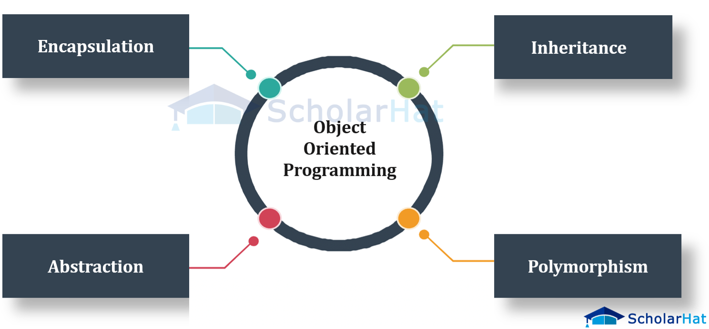
Object-Oriented Programming Features

Slide 14
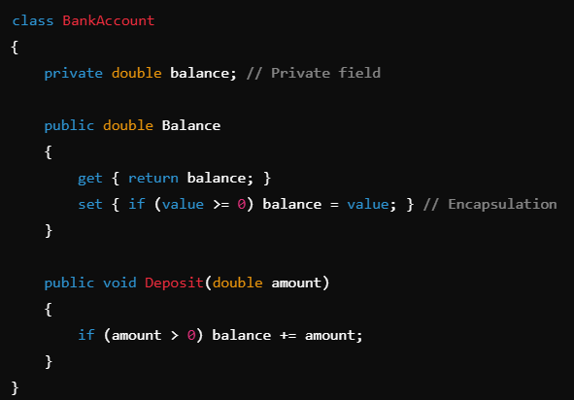
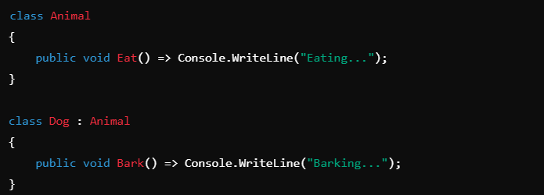
Object-Oriented Programming Features
Encapsulation
Definition:
Encapsulation bundles data and methods and restricts access using properties or access modifiers.
Inheritance
Definition:
Inheritance allows a derived class to acquire the properties and behaviors of a base class.

Slide 15
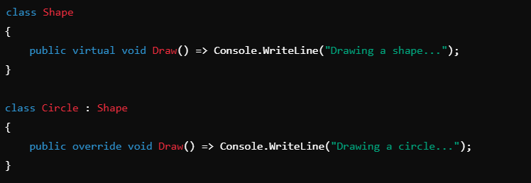
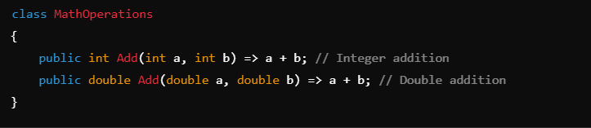
Polymorphism (Method Overriding)
Definition:
Polymorphism enables dynamic behavior using overriding.
Polymorphism (Method Overloading)
Definition:
Overloading allows methods with the same name but different parameters.

Slide 16
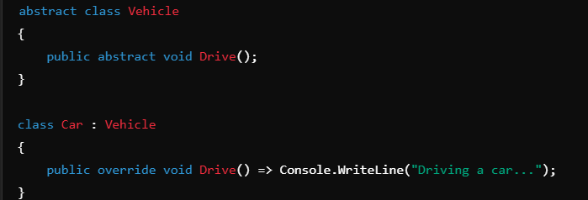
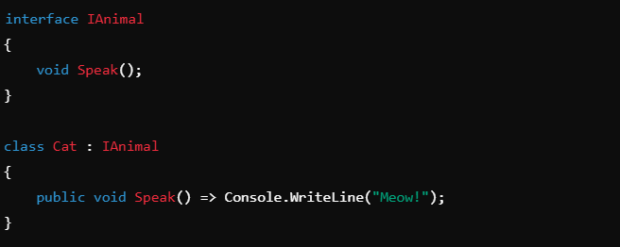
Abstraction
Definition:
Abstraction hides implementation details, exposing only essential features.
Interfaces
Definition:
Interfaces define a contract for classes to implement.

Slide 17
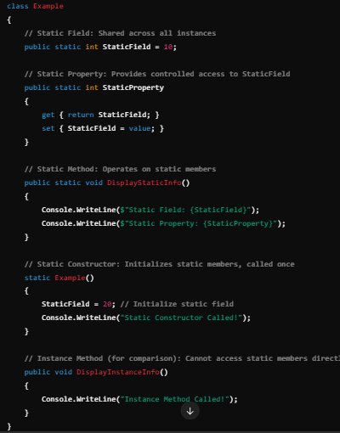
Static Members
Static Members belong to the type (class) rather than an instance of the class.
Can be accessed using the class name directly, without creating an object of the class.
Static members are shared across all instances of the class.
Types of Static Members:
Static Fields:
Shared across all instances, retains values for the type.
Static Methods:
Can only access static fields and methods directly.
Static Properties:
Provide encapsulated access to static fields.
Static Constructors: Used to initialize static data; runs only once, when the type is first accessed.

Slide 18
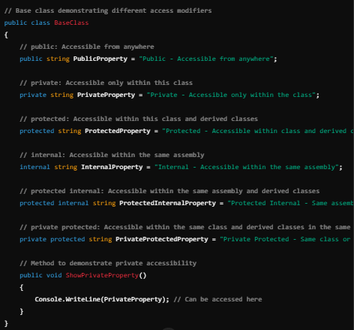
Access Modifiers
Access modifiers define the accessibility of class members:
public: Accessible from anywhere.
private: Accessible only within the containing class.
protected: Accessible within the containing class and derived classes.
internal: Accessible within the same assembly.
protected internal: Accessible within the same assembly and derived classes.
private protected: Accessible within the same class and derived classes in the same assembly.

Slide 19
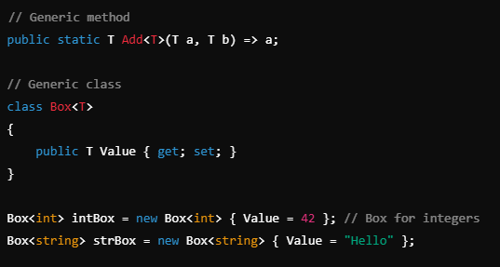
Generics and Collections
Generics
Definition: Generics allow you to define type-safe and reusable classes, methods, and interfaces.
Avoids runtime errors by enforcing compile-time type checking.
Enables creating collections, methods, and classes that work with any data type.
Type-safe collections (List<T>).

Slide 20
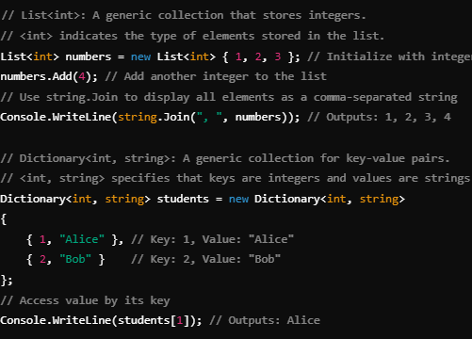
Generics and Collections
Collections:
Definition: Collections are used to store, manage, and manipulate data more efficiently.
Types of Collections:
Generic Collections (Type-Safe):
List<T>: Dynamic arrays.
Dictionary<TKey, TValue>: Key-value pairs.
Non-Generic Collections:
ArrayList: Stores heterogeneous data.
Hashtable: Stores key-value pairs (not type-safe).

Slide 21
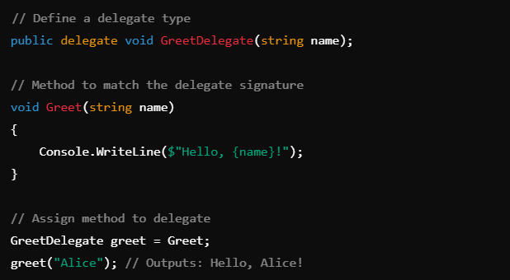
Delegates and Events
Delegates:
Definition:
Delegates are type-safe function pointers in C#.
They allow methods to be assigned to variables and passed as parameters.
Features:
Can point to methods with a matching signature.
Support multicasting (pointing to multiple methods).
Enable callback mechanisms.
Why Use Delegates?
Decoupling: Reduce tight coupling between components.
Callback Mechanisms: Allow passing behavior as parameters.
Multicasting: Call multiple methods using one delegate instance.

Slide 22
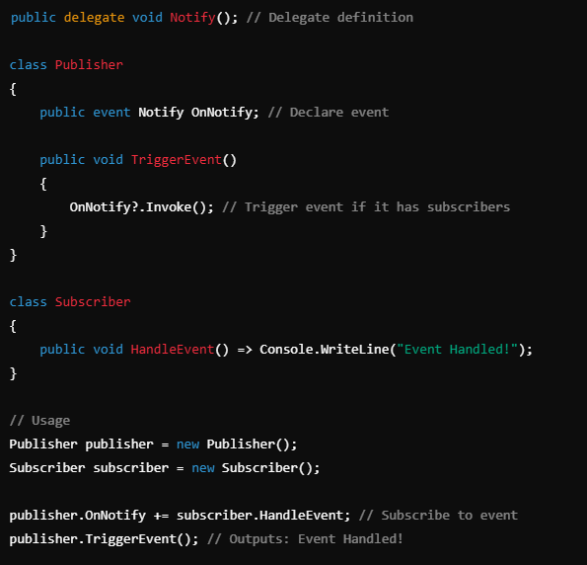
Delegates and Events
Events
Definition:
Events are special delegates used to notify other components about changes or actions.
They follow the Publisher-Subscriber Pattern.
Partial Classes: Enable splitting class definitions across multiple files
Key Points:
Events are declared using the event keyword.
Only the publisher can trigger the event.
Events can use any delegate type.
Workflow:
Publisher raises the event.
Subscribers handle the event.

Slide 23
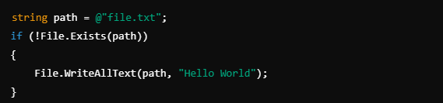
File I/O Operations
What is File I/O?
Definition:
File Input/Output (I/O) involves performing operations to read data from and write data to files.
Purpose:
Storing data for long-term use.
Processing text or binary files.
Key Classes (from System.IO):
File: Static methods for file operations.
FileInfo: Instance methods for file operations.
StreamReader and StreamWriter: For reading and writing text files.BinaryReader and BinaryWriter: For binary file operations.

Slide 24
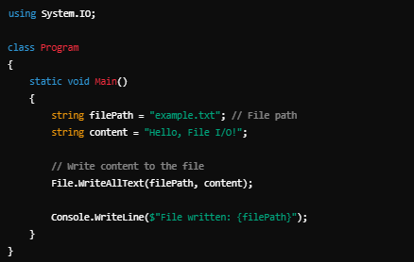
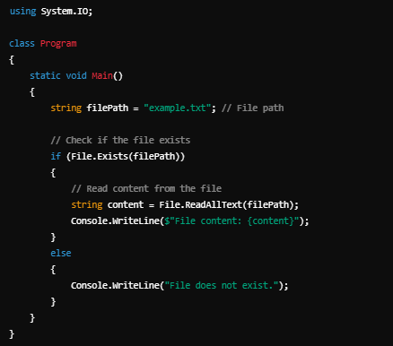
File I/O Operations

Slide 25
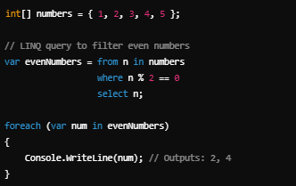
LINQ and Lambda Expressions
What is LINQ?
Definition:
LINQ (Language Integrated Query) provides a consistent way to query data from various sources like collections, databases, and XML.
Integrated directly into C#, allowing queries to be written directly in the language.
Advantages:
Type Safety: Ensures compile-time checking of queries.
Consistency: Same syntax for querying different data sources.
Readability: Makes code concise and easy to understand.

Slide 26
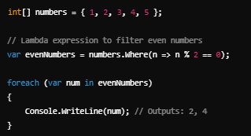
LINQ and Lambda Expressions
What are Lambda Expressions?
Definition:
Lambda expressions are concise, inline functions.
Syntax: (parameters) => expression.
Advantages:
Simplifies anonymous functions.
Used extensively with LINQ for short, clear queries.
Eliminates the need for separate method definitions.

Slide 27
LINQ and Lambda Expressions
LINQ Query Syntax vs. Method Syntax
Query Syntax:
Similar to SQL.
Easier to understand for DB devs .
Method Syntax:
Uses extension methods like Where, Select, etc.Code Example:

Slide 28
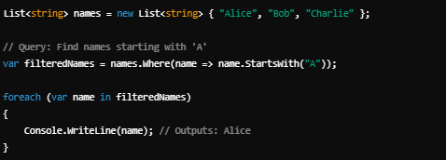
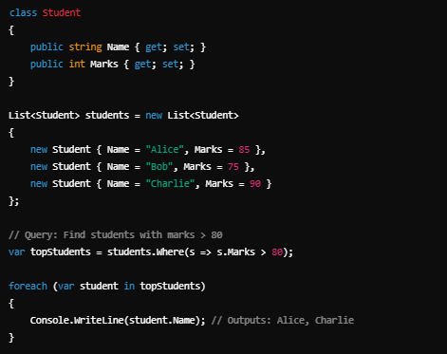
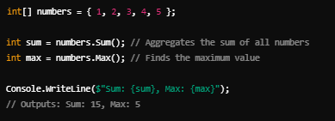

Slide 29
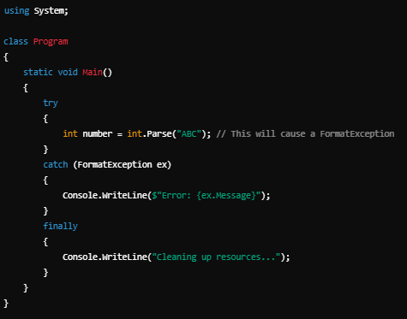
Exception Handling
What is Exception Handling?
Definition:
Mechanism to handle runtime errors, ensuring the program doesn’t crash abruptly.
Enables developers to address unexpected situations gracefully.
Benefits:
Improves program reliability and stability.
Simplifies debugging and maintenance.

Slide 30
Exception Handling
Key Exception Handling Constructs
Keyword | Purpose
try | Wraps the code that may cause an exception.
catch | Handles exceptions thrown in the try block.
finally | Executes cleanup code, whether or not an exception occurred.
throw | Re-throws an exception to the calling method or indicates an exception explicitly.
Code execution → Exception occurs → Try block → Catch block → Finally block → Exit program.

Slide 31
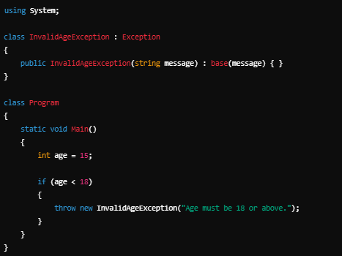
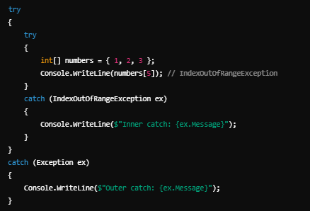

Slide 32
Exception Handling
Types of Exceptions
Exception | Description
System.Exception | Base class for all exceptions.
System.NullReferenceException | Thrown when accessing a null object.
System.IndexOutOfRangeException | Thrown when accessing an invalid index in arrays or collections.
System.DivideByZeroException | Thrown when dividing a number by zero.
System.IO.IOException | Thrown for input/output errors.

Slide 33
Asynchronous Programming
What is Asynchronous Programming?
Definition:
A programming model that allows a program to perform other tasks while waiting for long-running operations to complete.
Frees up the main thread to handle other work, improving responsiveness and efficiency.
Key Benefits:
Non-blocking code execution.
Efficient use of system resources.
Improves application responsiveness (e.g., UI apps).

Slide 34
Asynchronous Programming
Key Constructs for Asynchronous Programming
Keyword | Purpose
async | Marks a method as asynchronous.
await | Suspends the execution of an async method until the awaited task completes.
Task | Represents an asynchronous operation.
Task<T> | Represents an asynchronous operation that returns a value of type T.

Slide 35
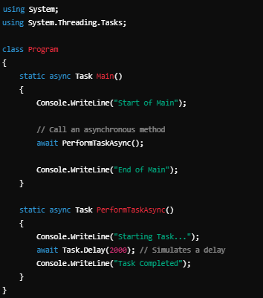
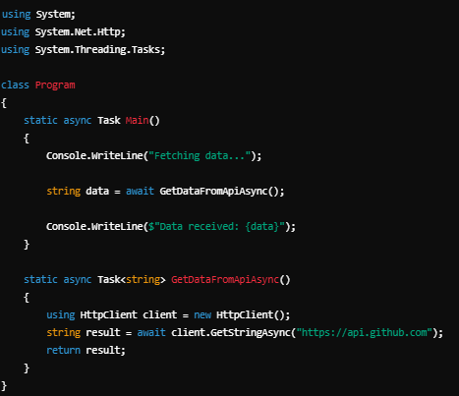

Slide 36
Asynchronous Programming
Synchronous vs Asynchronous
Synchronous | Asynchronous
Executes tasks one after another (blocking). | Allows tasks to run concurrently.
May block the UI thread in applications. | Keeps the UI responsive and efficient.
Example: Reading a file line by line. | Example: Fetching data from an API.

